Slide 1
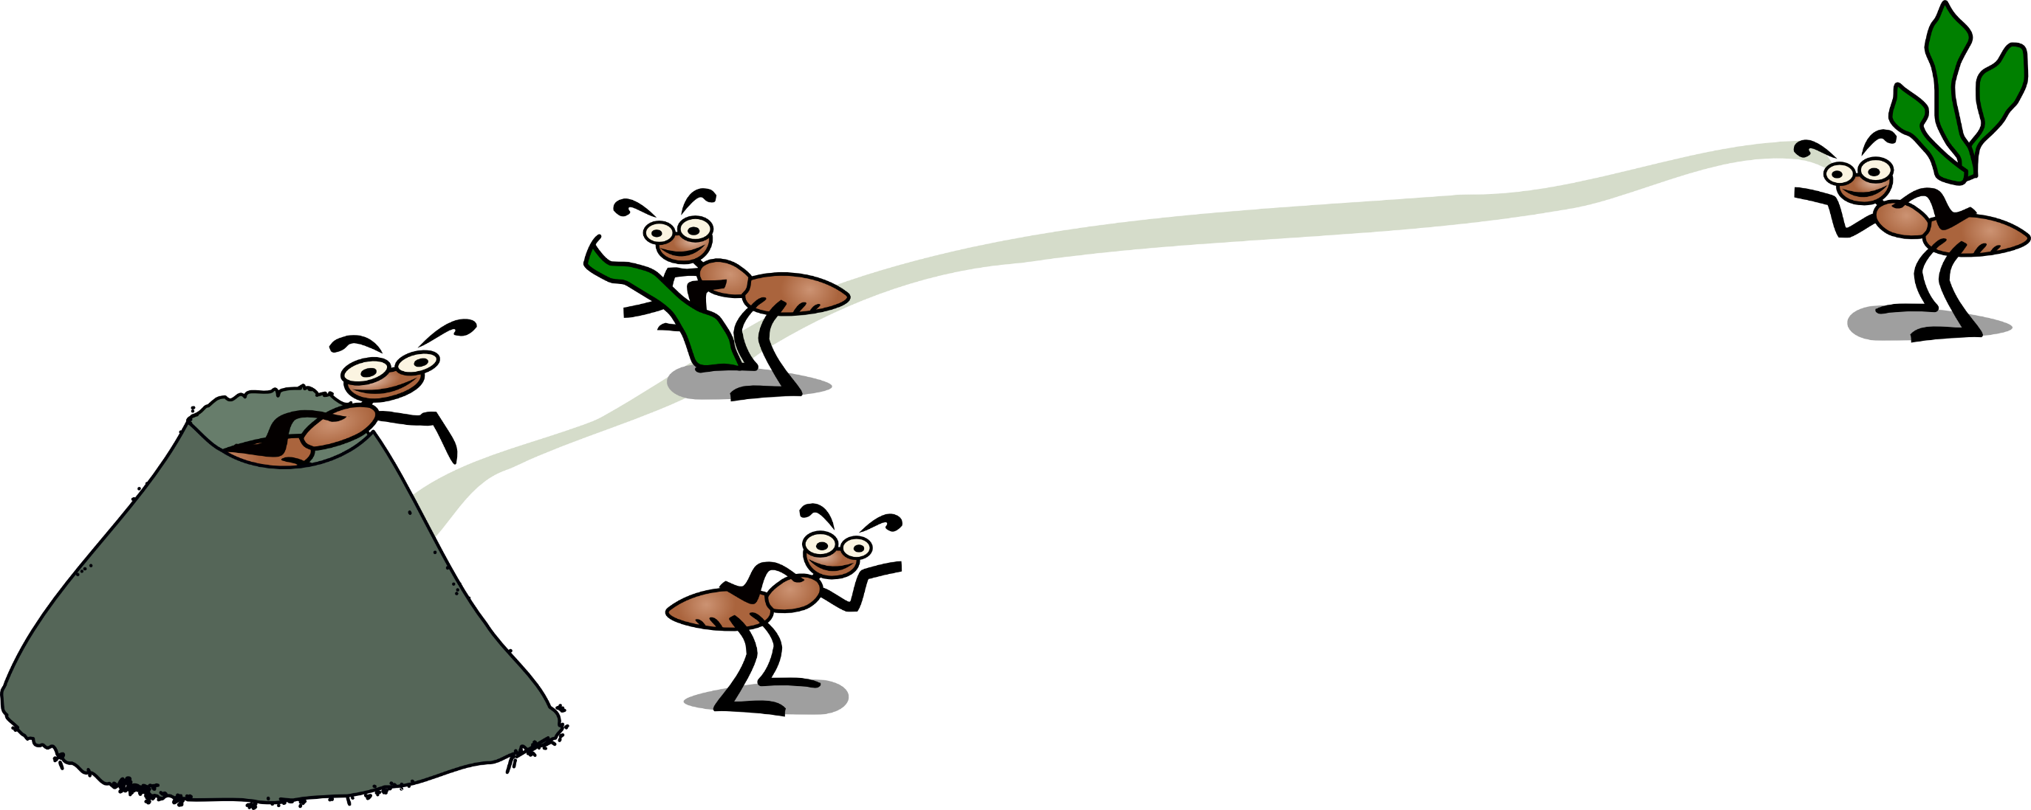
Presentation Autonomous Systems 2018-2019
Social insects as a Multi-Agent System
Jose Luis Pedraza Roman

Slide 2
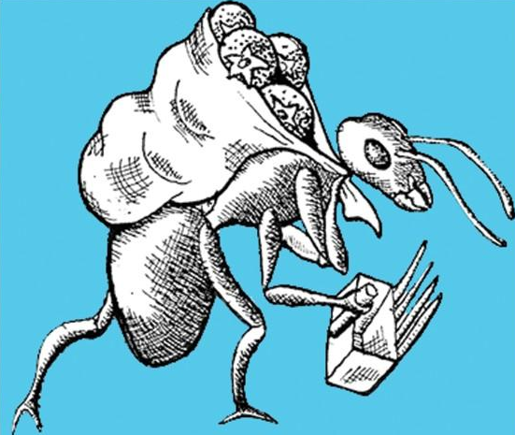
Contents
01
Introduction and concepts
Colonies of social insects, foraging and stigmergy
02
PEAS specification
Perfermance, Environment, Actuators, Sensors
03
Model description
Description of the system that can be found in netlog.
04
Design of the multi-agent system with AML
Entity, society and preceptor-effector diagrams for model.

Slide 3


Introduction and concepts
Introduction to the application domain
Colonies of social insects can be viewed as highly parallel, distributed systems for solving the problems intrinsic to colony survival and reproduction.
Stigmergy
The subject of stigmergy is best approached by considering the ways in which embodied agents (call them robots) can interact.
Foraging
In this model, a colony of ants forages for food.
Foraging consists in searching and collecting items in an environment and move them to storage point(s).

Slide 4
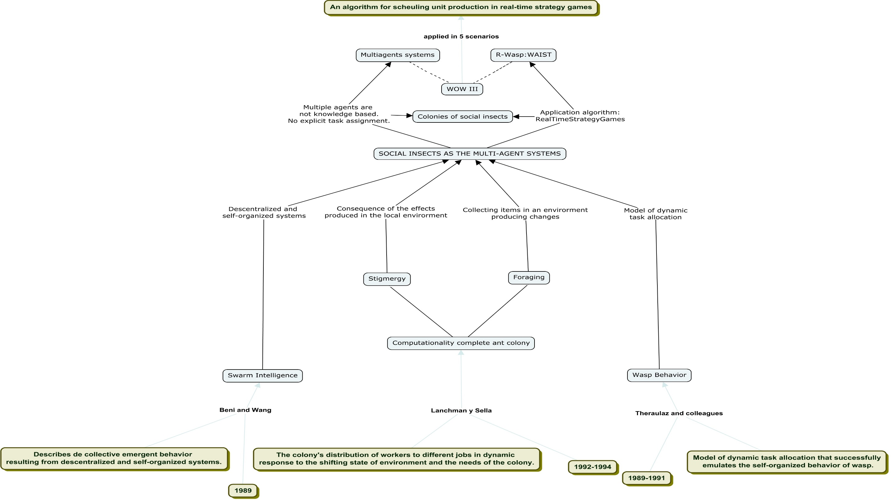
Mind map

Slide 5

PEAS specification
Multi-Agent System
Performance: Their behavior consists in the search and collection of food by individual agents who carry out intelligent behavior in group.
Environment:The MAS works in a simple environment that consists of a nest of ants and food clusters.
Actuators: The ants look for food and when they find it they leave pheromones on the way to the nest.
Sensors: The ants are equipped with a pheromone tracking system

Slide 6
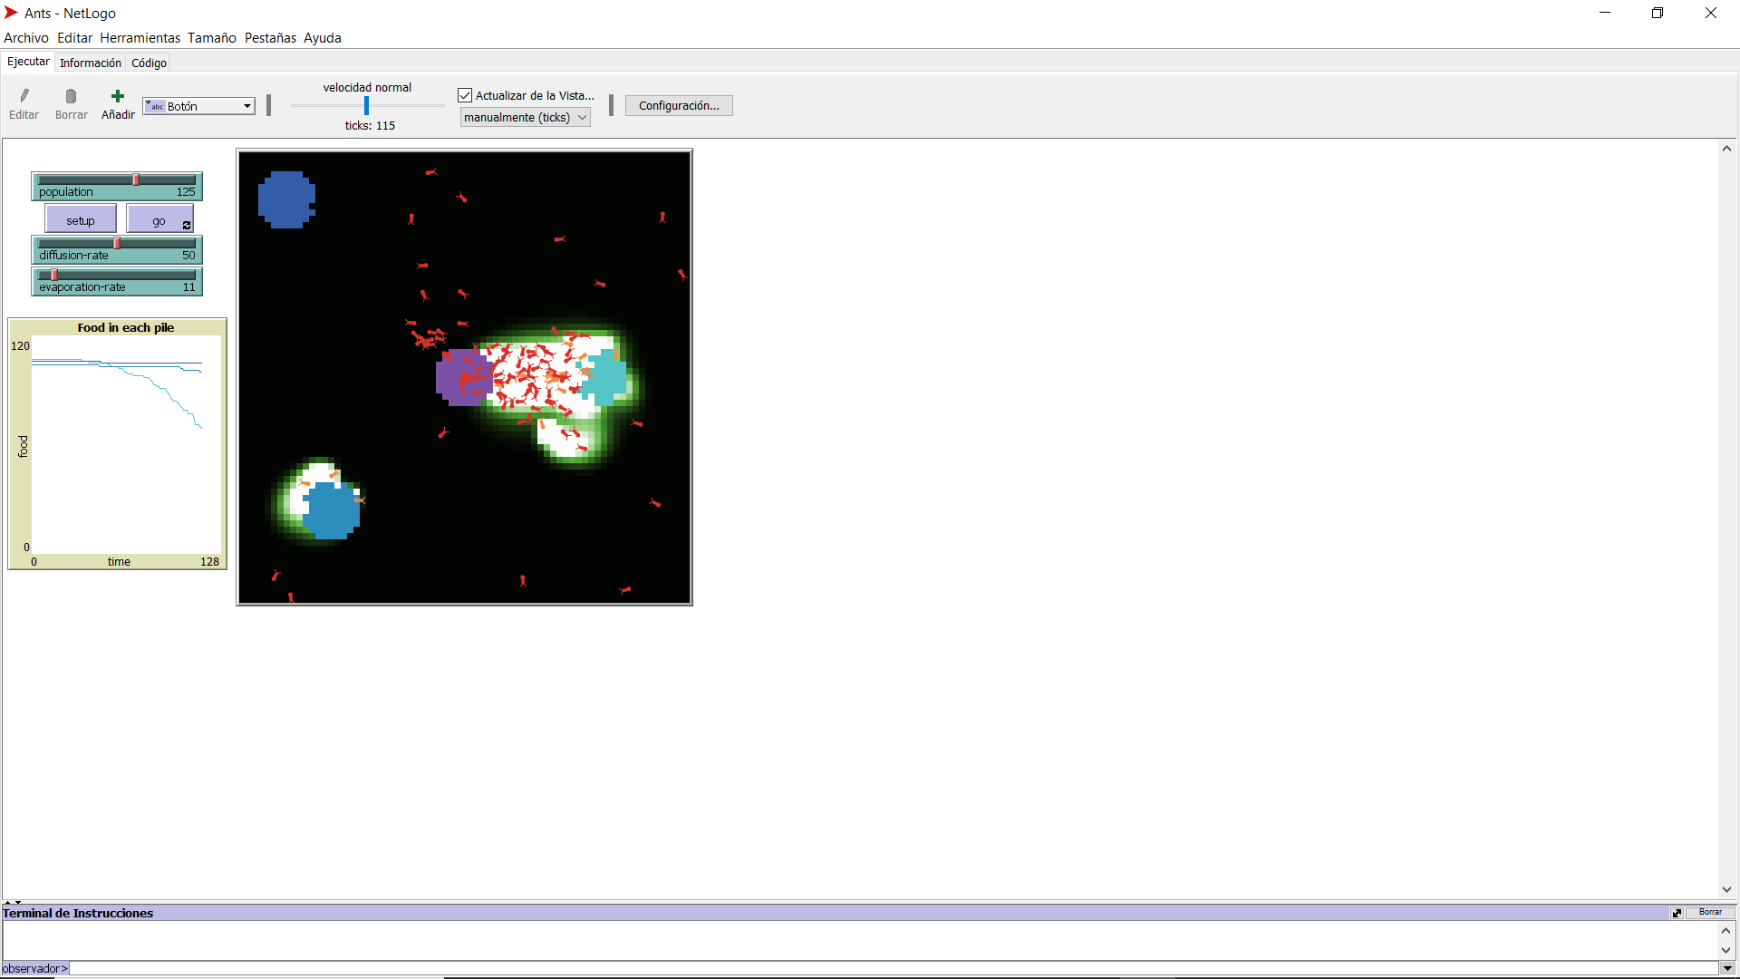

Model description ants.logo
When an ant finds a piece of food, it carries the food back to the nest, dropping a pheromone trail as it moves. When other ants smell the pheromone, they follow the trail toward the food. As more ants carry food to the nest, they reinforce the trail.

Slide 7
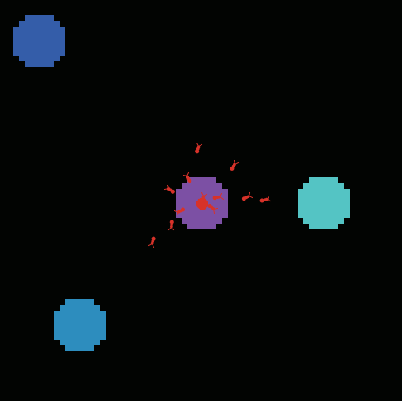
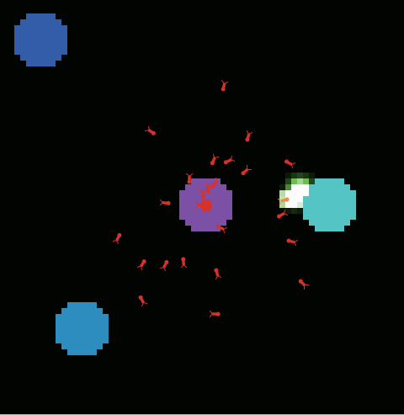
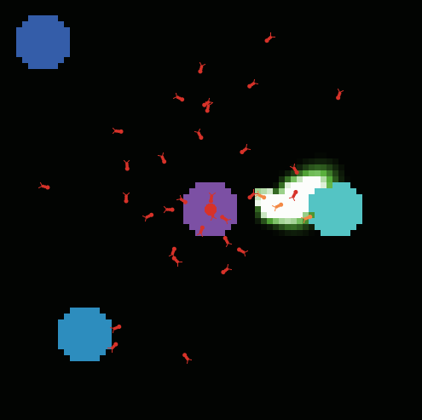
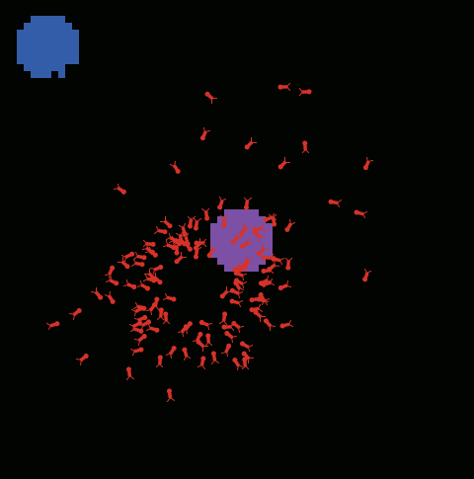
What entity does what, and in what order?
1º) Ants come out of the nest.
They move around looking for food.
2º) When they find food, they segregate a trail of pheromones from the cluster to the nest.
3º) If the ants find the trail, they follow it.
4º) If the ants lose the trace, they move by a random search algorithm.

Slide 8
Design of the MAS with AML
Entity diagram
This diagram offers the basic view on the structure of the MAS.
Society diagram
Society diagram emphasises representation of social roles,
social relations between entity types.
Perceptor-effector diagram
This diagram is able to represent the components that the entity type can use for sensing the environment and reacting on stimuli.

Slide 9
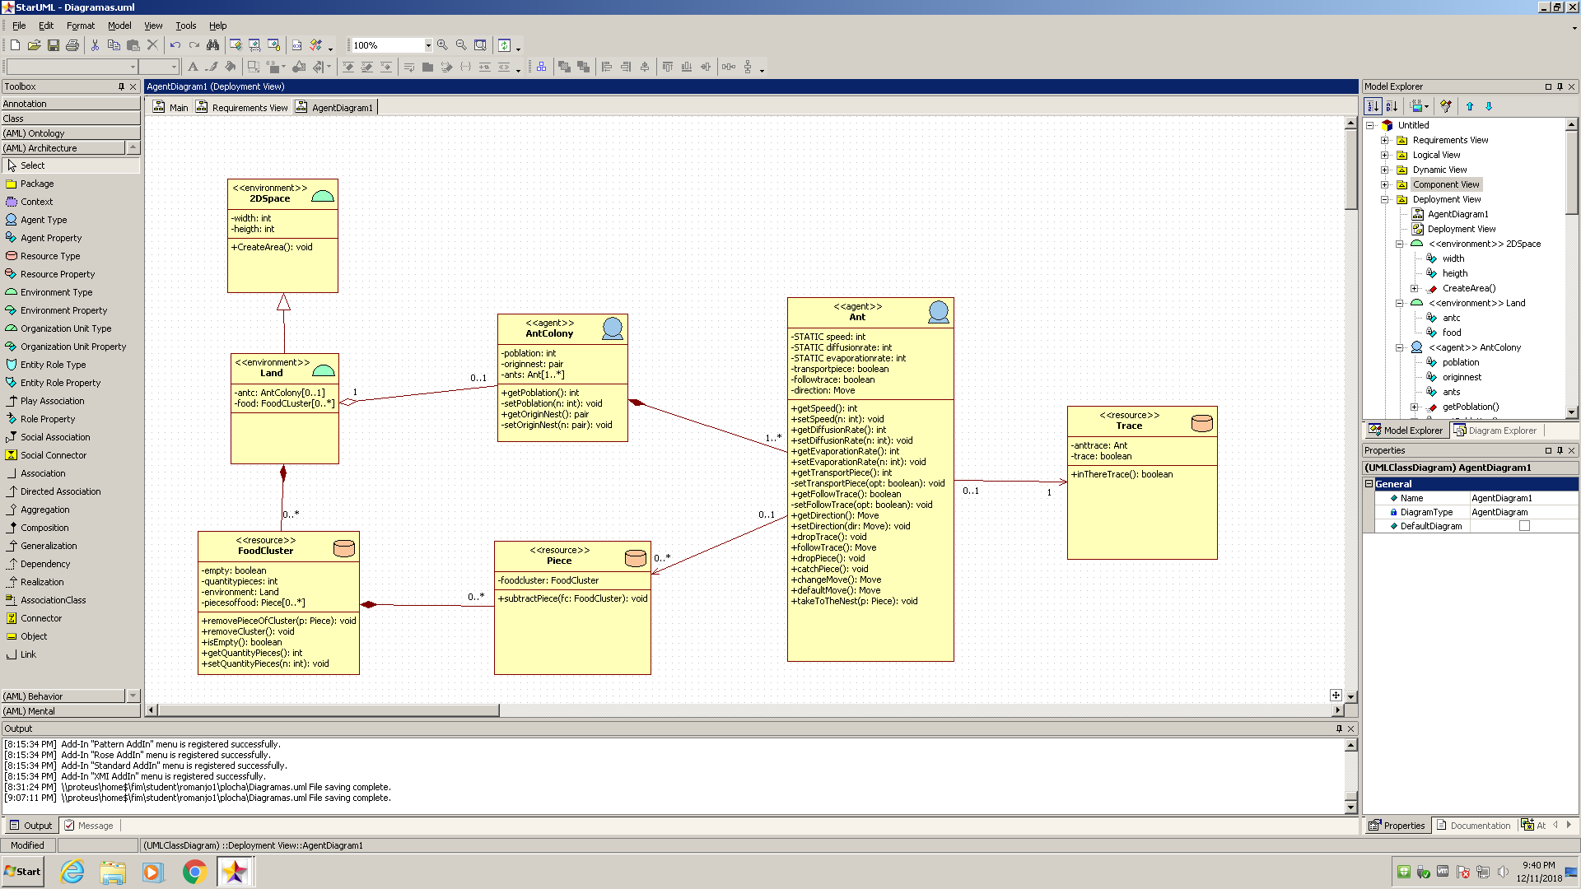
Entity diagram
Entity type | Name of the entity type | Comment
Environment type | 2DSpace | First layer that dimensions the environment
Environment type | Land | Second layer where the objects are
Agent type | AntColony | Ants as a collective (a unique collective for the model)
Agent type | Ant | Individual agent who will form with his behavior the collective behavior of the model
Resource type | FoodCluster | Stack of food consisting of a specific number of pieces
Resource type | Piece | Unit of food that an ant can carry
Resource type | Trace | Pheromones trail

Slide 10
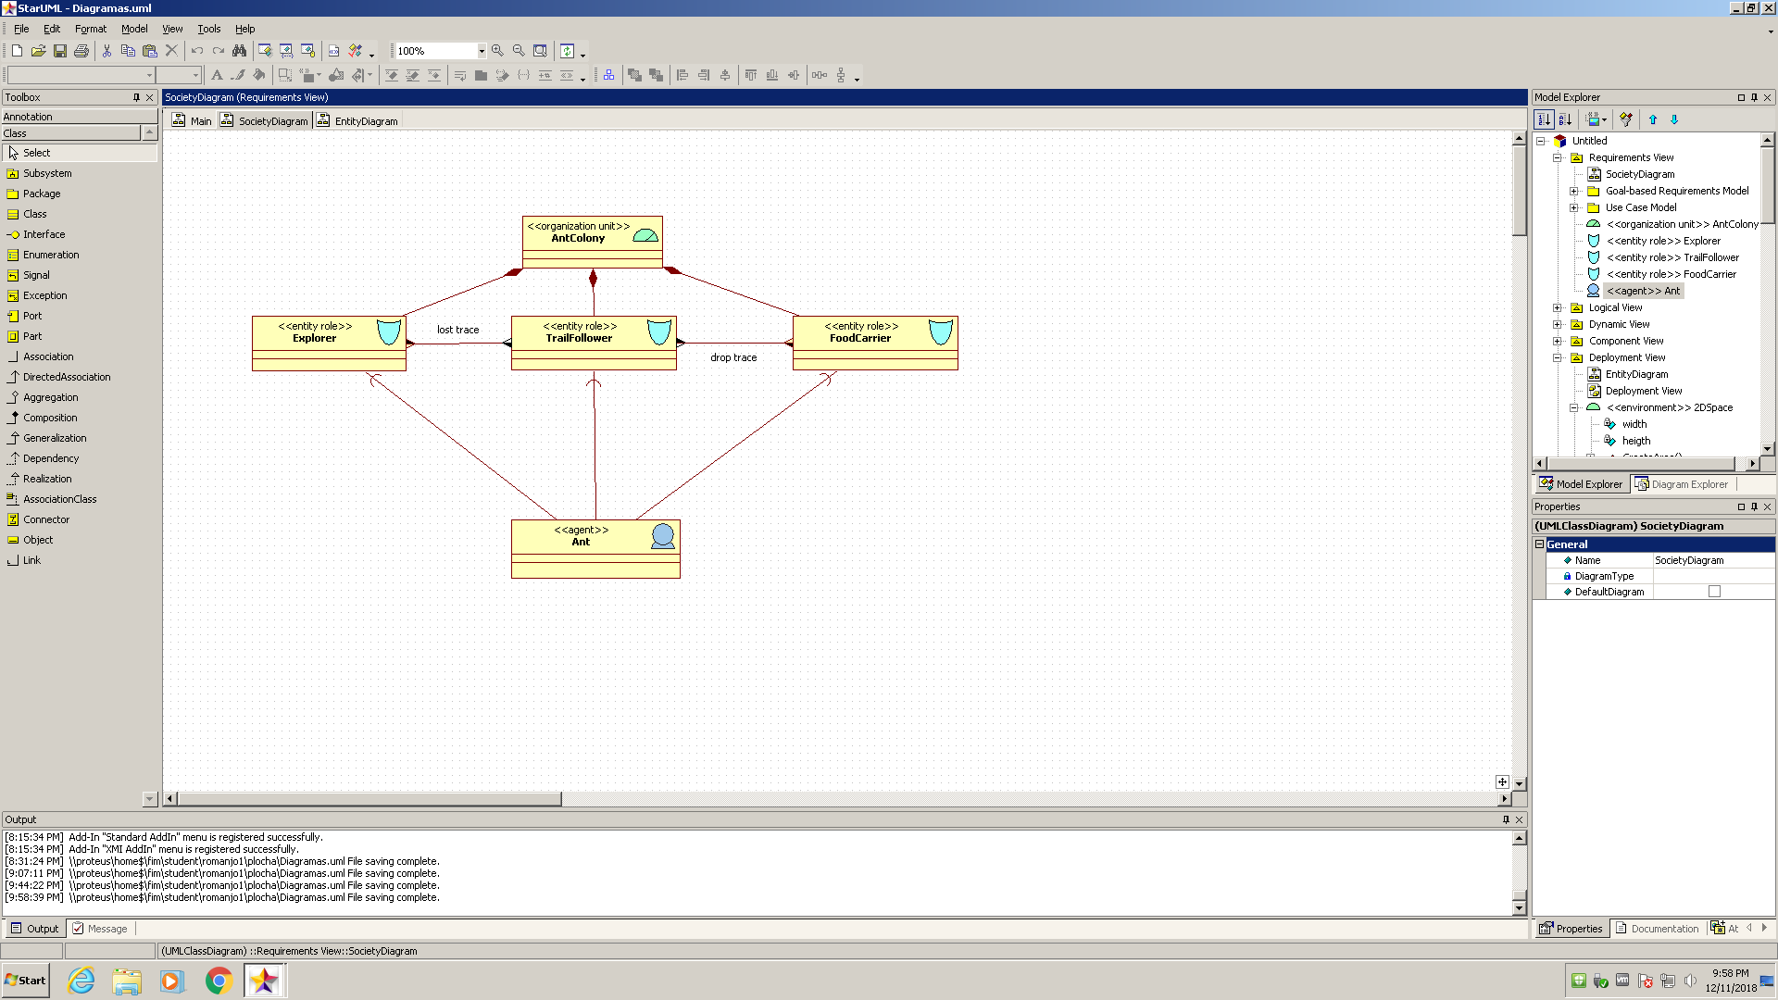
Society diagram
Type of the element | Name of the element | Comments
Organization unit | AntColony
Entity role | Explorer
Entity role | TrailFollower
Entity role | FoodCarrier
Agent | Ant
Play association |  | Between Explorer-Ant
Play association |  | Between TrailFollower-Ant
Play association |  | Between FoodCarrier-Ant
Social associations | Lost trace | Between Explorer-TrailFollower
Social associations | Drop trace | Between TrailFollower-FoodCarrier

Slide 11
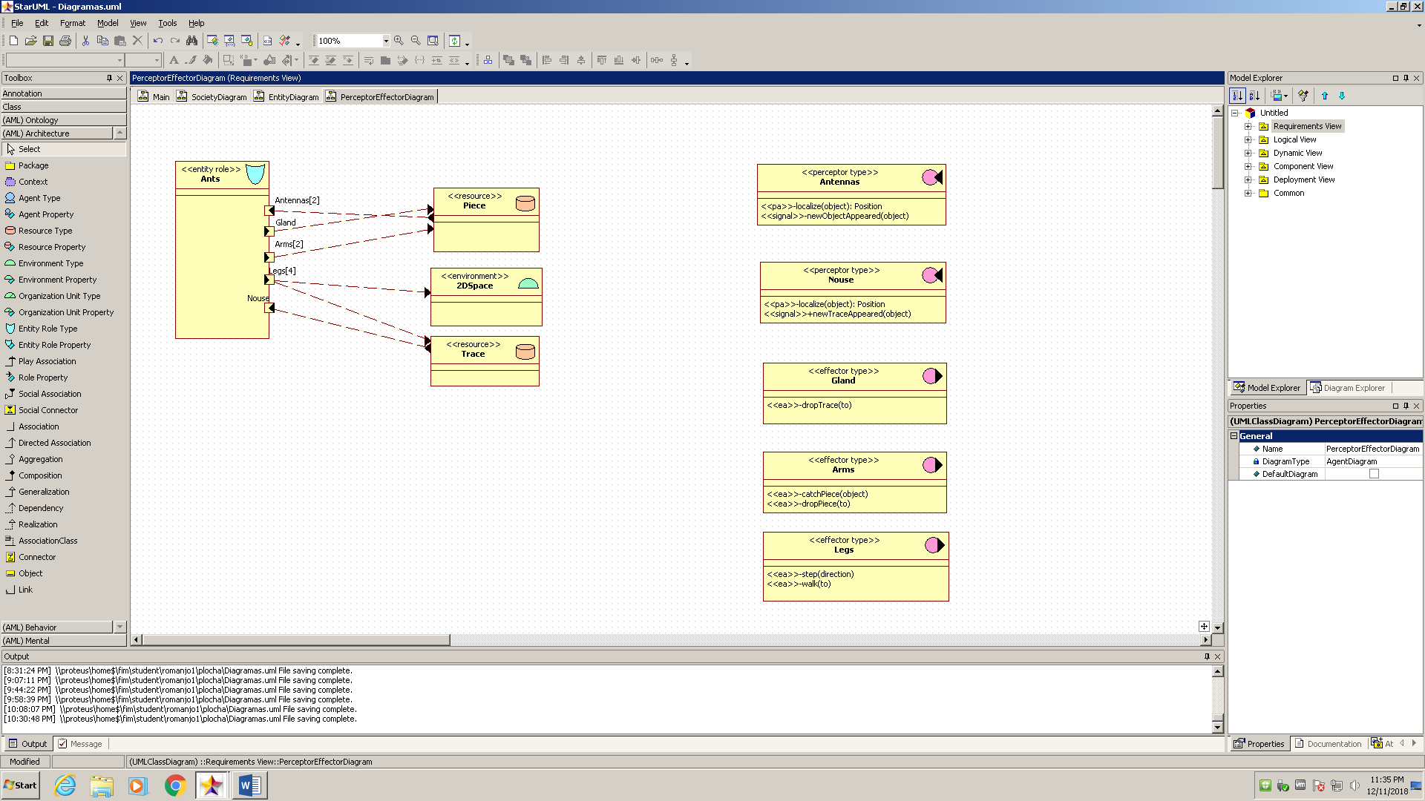
Perceptor-Effector diagram
Type of the element | Name of the element | Comments
Perceptor type | Antennas | Two antennas to feel the land
Perceptor type | Nouse | To smell the trail
Effector type | Gland | To leave the trace of pheromones
Effector type | Arms | To take the piece of food from the cluster
Effector type | Legs | To move around the environment and carry out its objectives
Environment | 2DSpace
Resource | Trace
Resource | Piece

Slide 12
Thank You

